Slide 1
Microalgae for jet fuel
The biofuel for air transport !!

Slide 2
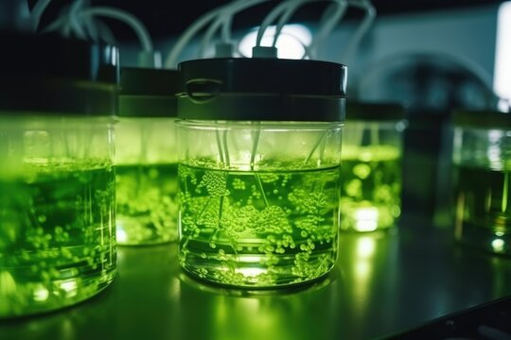
What are Microalgae?:
Microalgae are a variety of algae that are invisible to the eye and can grow in the form of chains and colonies.
They contain chlorophyll and so carry out photosynthesis.
They can be cultivated in mass quantity (biomass) and they produce sugar and other carbon containing substances by consuming CO2 and water.

Slide 3

Biomass fuel and aviation industry:
Around 2 to 3% carbon emissions are from the aviation industry.
Consumption of fossil fuels for aviation is increasing year on year with no sign of reduction, which is a huge threat to climate and environment.
International Airport Transport Association (IATA) has recognized bio jet fuel as the most suitable substitute for fossil fuels.
Bio jet fuel is found to be superior to fossil jet fuels in many cases.

Slide 4
Three generations of biomass sources:
First generation – edible crops
Second generation – animal fats, used cooking oil, non-edible seeds, soaps, sugars etc.,
Third generation - Microalgae

Slide 5
Advantages of Microalgae:
Oil from microalgae is not edible and so it does not affect food system
10 times more oil per acre when compared to other biofuel crops
High growth rate and carbon fixing efficiency
Produce other by products like proteins, livestock food materials etc., which can be used in other industries.

Slide 6
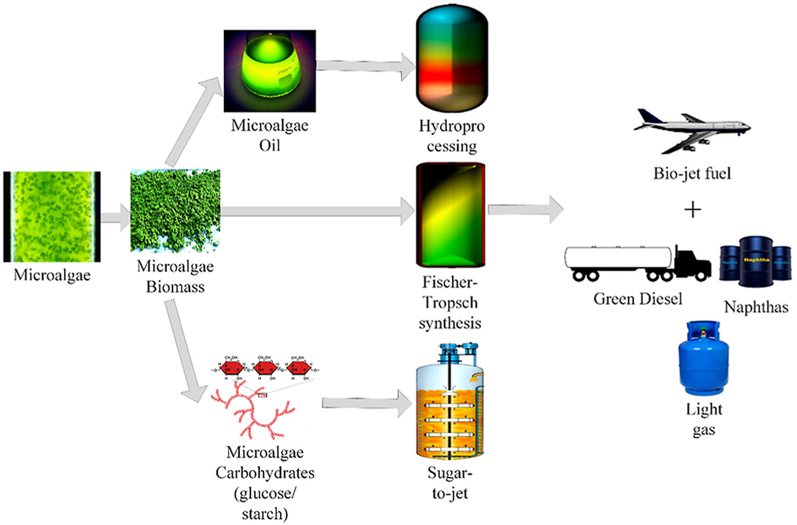
Algae to fuel:

